Slide 1
INTRODUCTION TO SDLC MODELS

Slide 2
Overview
Waterfall Model
Iterative Model
Incremental Model
Agile Model

Slide 3
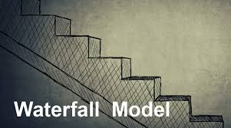
WATERFALL MODEL
The Waterfall Model was the first Process Model to be introduced.
It is also referred to as a Linear Sequential life cycle model.
In a waterfall model, each phase must be completed before the next phase can begin and there is no overlapping in the phases.

Slide 4
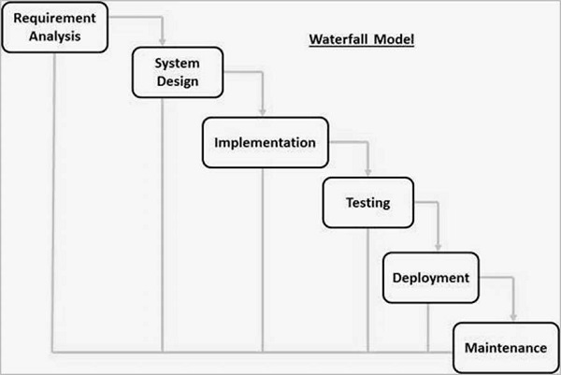
WATERFALL MODEL-DESIGN

Slide 5
EXAMPLE
We have a Bank which approaches to our company to make a Banking-Application.
REQUIREMENTS AND ANALYSIS:
Requirements are gathered which would be told by the client and will be discussed by the business analyst and the team.
Requirements can be like:
Will the banking application be used in more than one country?
Do we have to support multiple languages?
How many users are expected to use the application? etc..

Slide 6
SYSTEM DESIGN-
On the basis of the client requirements from the previous phase the senior members of the project team design the architecture.
EG. banking application needs to have redundant backup.
IMPLEMENTATION-
The development team works on coding of the project.
EG. Since the application is a banking application and security was a high priority in the application requirements, they implement several security checks, audit logging features in the application.

Slide 7
TESTING-
The testing team tests the complete application and identifies any defects in the application and they are fixed by the developers and the testing team tests the fixes to ensure that the defect is fixed.
EG. Security testing teams were assigned to test the security of the banking application.
DEPLOYMENT-
The team builds and installs the application then deploy that application on the servers.

Slide 8
MAINTENANCE-
During the maintenance phase, the team ensures that the application is running smoothly on the servers without any downtime.
Issues that are reported after going live are fixed by the team and tested by the testing team.

Slide 9

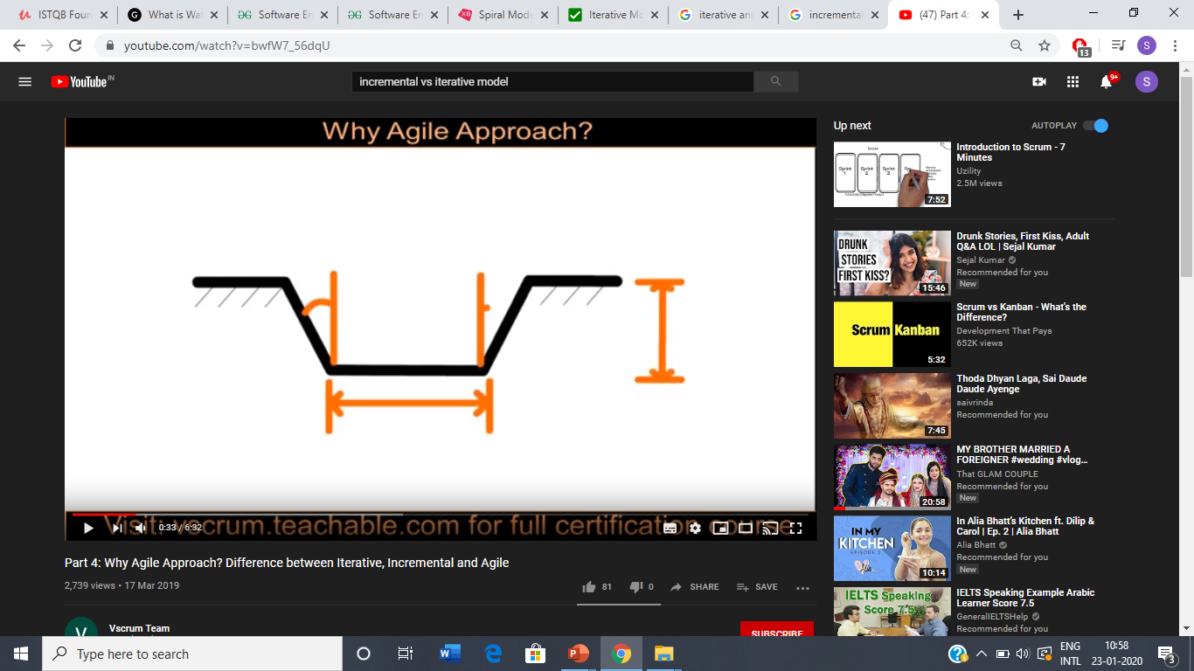
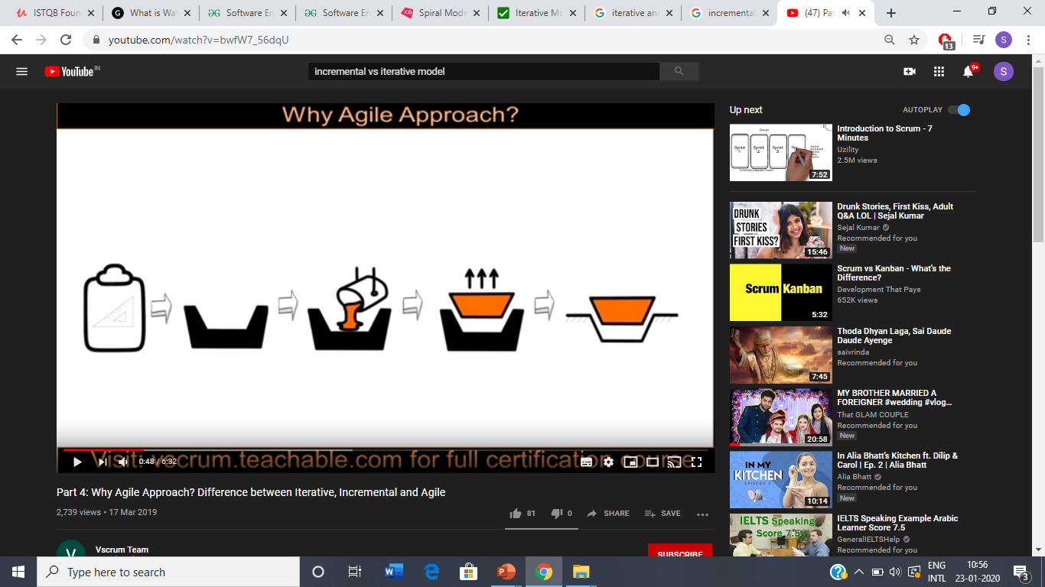

Slide 10

PROS:
Simple and easy to understand and use.
Clearly defined stages.
Phases are processed and completed one at a time.

Slide 11
DRAWBACKS IN WATERFALL
Once the first phase is completed and next phase has started then there is no way to going back on the previous phase. This is one of the issues to the failure of the waterfall model.
The waterfall model assumes that all the customer requirements can be completely and correctly defined at the beginning of the project, but actually if the customer is not satisfied with the delivered product then adding changes to the product can be costly and difficult to implement.

Slide 12
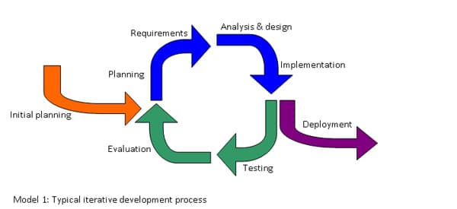
ITERATIVE MODEL
Iterative development occurs when groups of features are specified, designed, built, and tested together in a series of cycles, often of a fixed duration.
Iterations may involve changes to features developed in earlier iterations, along with changes in project scope.

Slide 13
EXAMPLE
(Can be considered as 1st phase)
In bank-application we made a working app with some features and we will get a review from the customer and then deploying it in the ..
(2nd Phase )
Then, we added some new features in the application again and then deploying it and it goes on.
So repetition goes on and it becomes iterative in nature.

Slide 14
ADVANTAGES:
More flexible – less costly to change scope and requirements.
Easier to test and debug during a smaller iteration.
Each iteration is an easily managed milestone
DISADVANTAGES:
More time is required as when we are deploying the software we need to get it reviewed by the customer that whether any changes may be required or not.

Slide 15
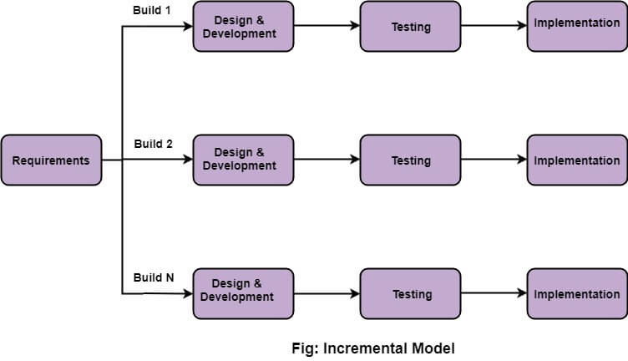
INCREMENTAL MODEL
Incremental Model is a process of software development where requirements are broken down into multiple modules of software development cycle.(System will be delivered in parts.)
Requirement:
Client knows about the full requirements.
Customer does not have to wait for the project.

Slide 16
EXAMPLE
If the customer says this month we need 5 features implemented in the bank application. Then we will read the requirements for only 5 features ,we will analyse and test those features and implement them .
Next month, we will take another 5 new features to analyse and test.
In 1st month it gets 5 features and in 2nd month it gets 10 features.
So, the software slowly grows incrementally by a few pieces every month.

Slide 17
ADVANTAGES:
The software will be generated quickly during the software life cycle.
Throughout the development stages changes can be done
This model is less costly compared to others
DISADVANTAGES:
It requires a good planning designing
Problems might cause due to system architecture as such not all requirements collected up front for the entire software lifecycle.

Slide 18
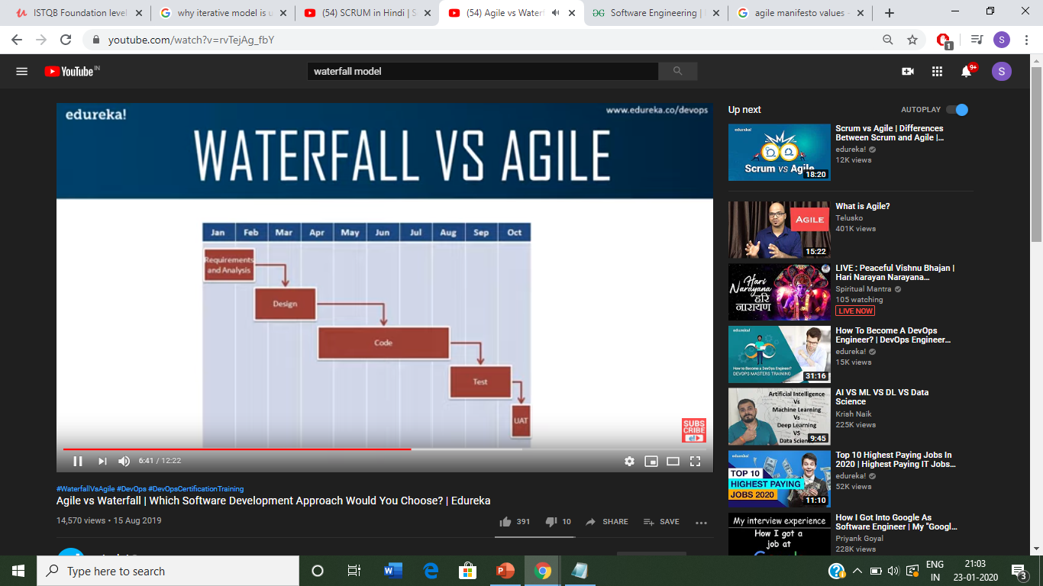
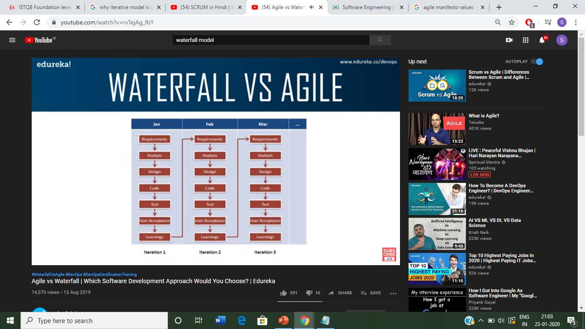
WATERFALL VS AGILE

Slide 19
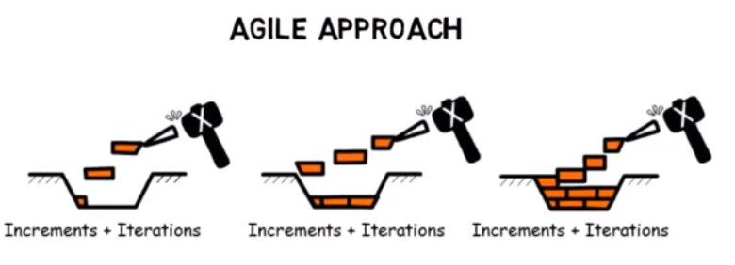
AGILE MODEL
The term AGILE means the ability to respond to changes-
changes from requirements, technology, people.
It is a iterative and a incremental process.
Engineering actions are carried out by cross functional teams.

Slide 20

EXAMPLE
We will be having a huge application involving chunks of code (frontend, backend, UI).

Slide 21
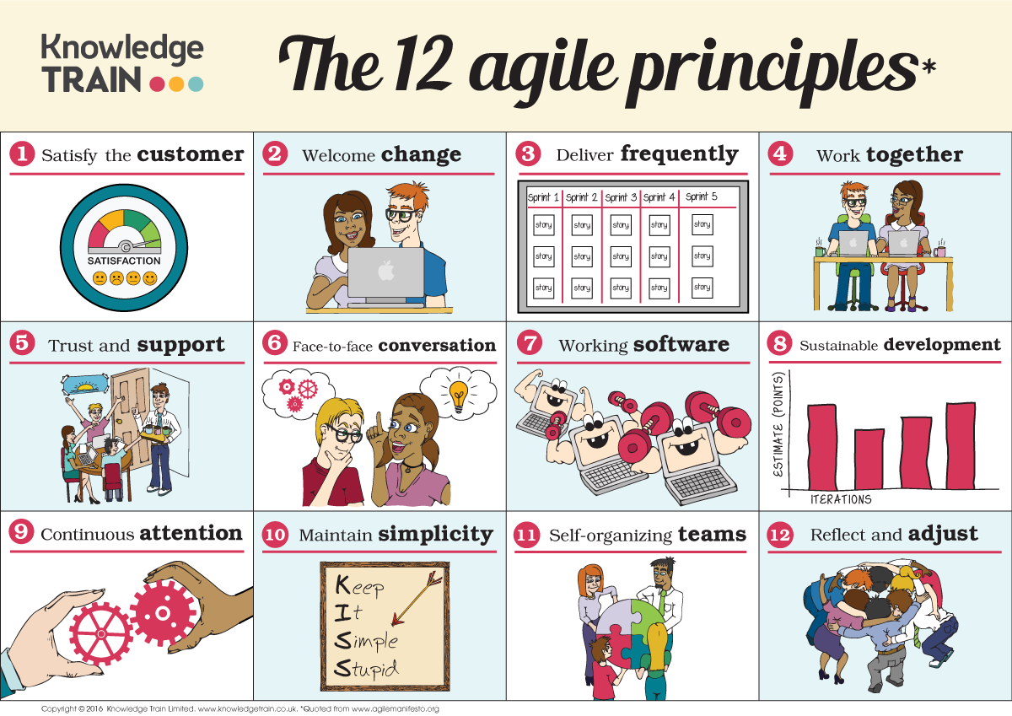
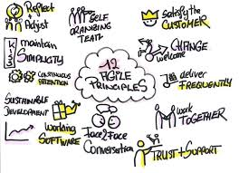
PRINCIPLES

Slide 22
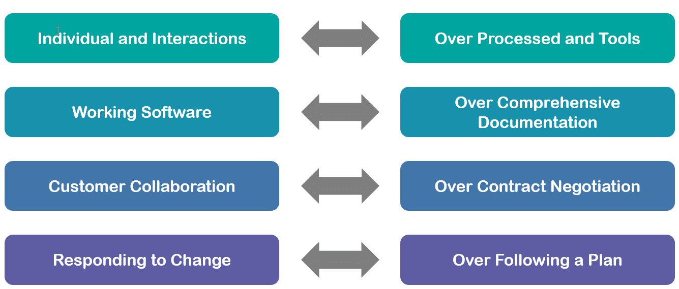
AGILE MANIFESTO/VALUES

Slide 23

HOW CAN WE IMPLEMENT IT???

Slide 24
BY USING FRAMEWORKS
SCRUM
EXTREME PROGRAMMING
LEAN
KANBAN CRYSTAL

Slide 25
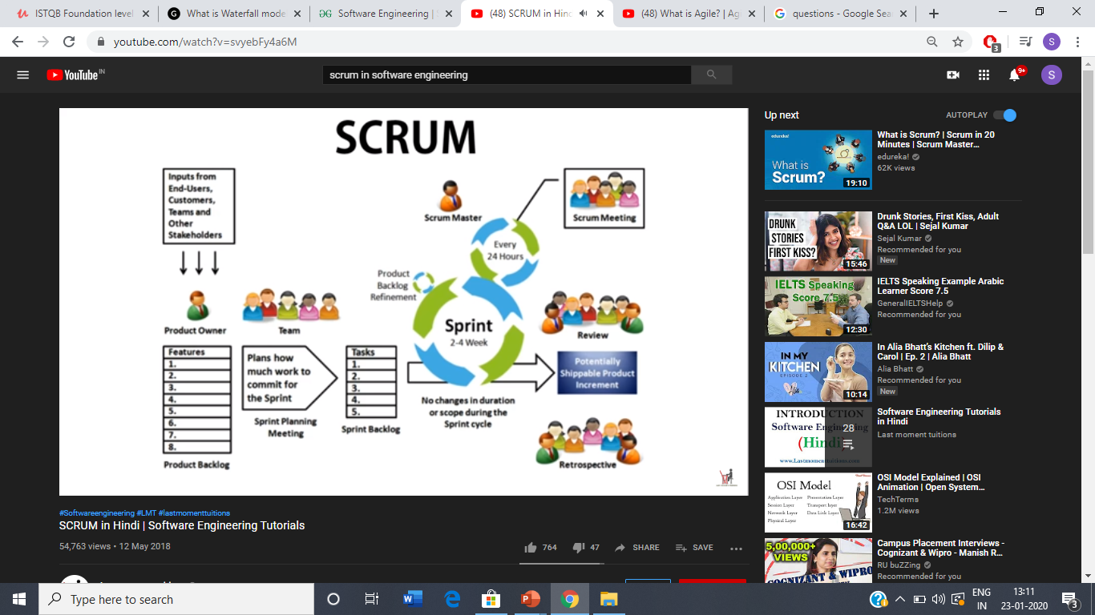

Slide 26
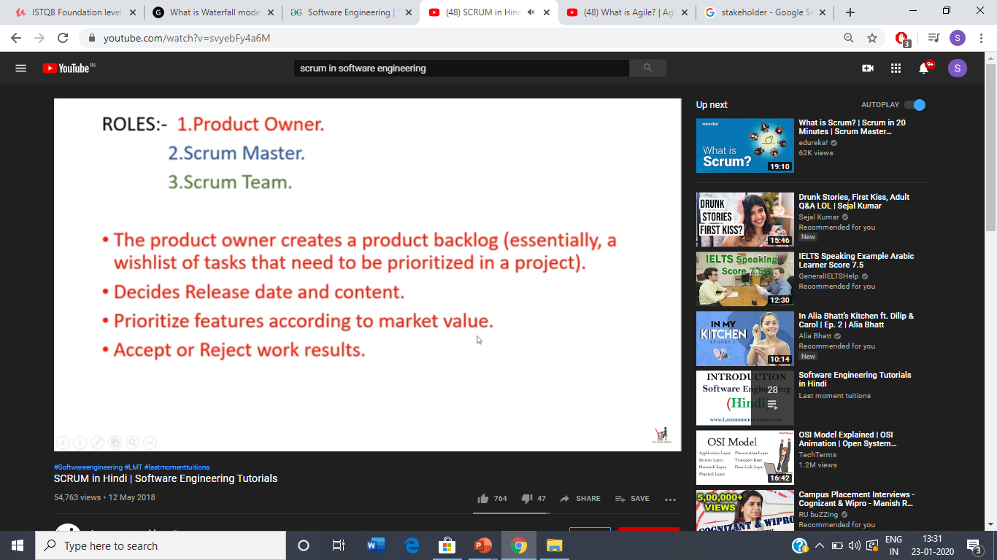

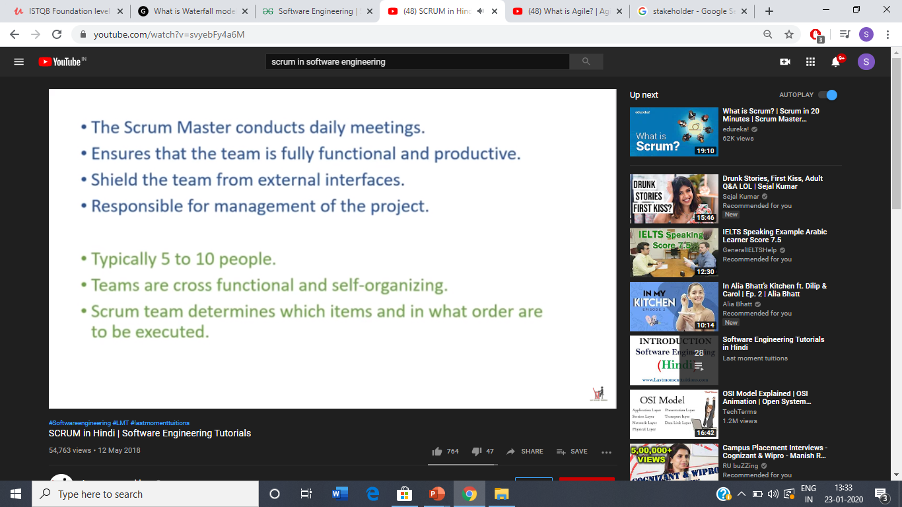

Slide 27
PROS:
Because of high customer involvement we receive feedbacks quickly , and make decisions.
Lesser Risk is involved.
Improving Quality.
CONS:
As agile focuses on quick delivery so there can be an issue with hitting deadlines, it seems easy but is difficult to implement

Slide 28
QUES: The waterfall model of software development is
A reasonable approach when requirements are well defined.
A good approach when a working program is required quickly.
The best approach to use for projects with large projects with large development teams
An old fashioned model that is rarely used any more.

Slide 29
QUES: Each iteration in incremental model passes through the:
Communication and modeling phases
Planning and construction phases
Deployment and maintenance phases
All phases

Slide 30
QUES: How do you create agile processes to manage unpredictability?
Requirements gathering must be conducted very carefully.
Risk analysis must be conducted before planning takes place.
Software increments must be delivered in short time periods.
Software processes must adapt to changes incrementally.
Both c and d.

Slide 31
ANY Q/A

Slide 32
Thank You

